Slide 1
Linux Assembly
Armine Hayrapetyan

Slide 2
Outline
Macros
Arguments for Macros
Local Labels in Macros
Including External Files

Slide 3
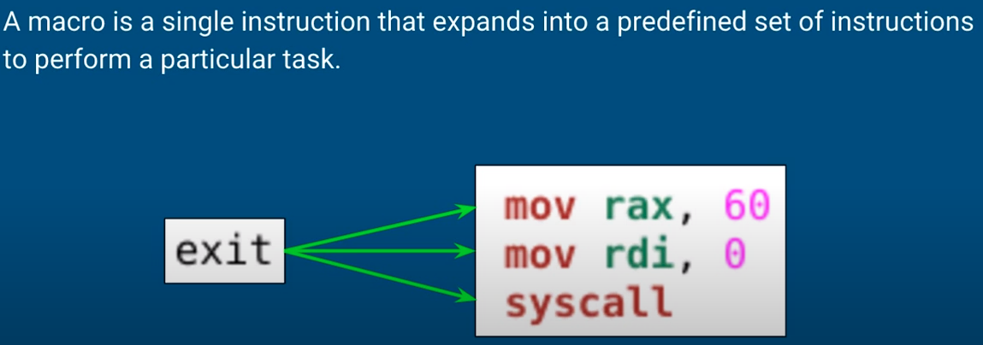
Macros

Slide 4
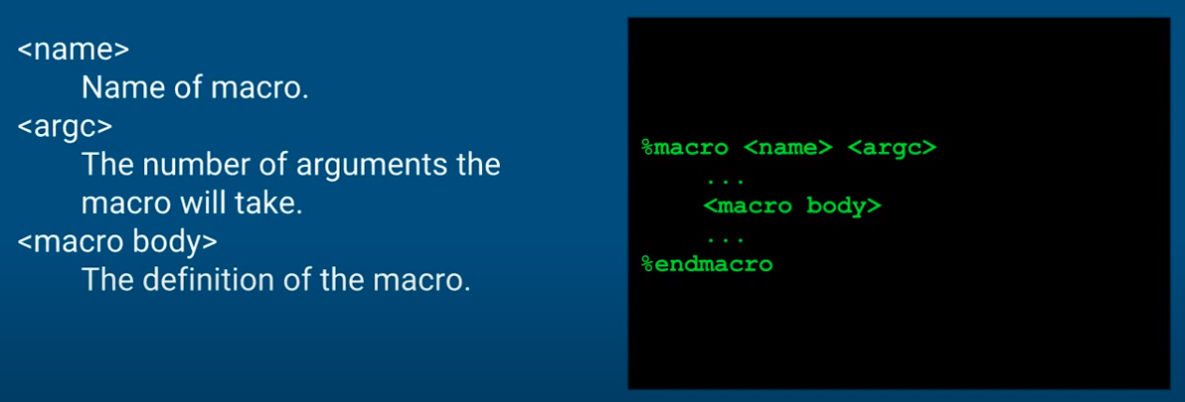
Defining Macros

Slide 5
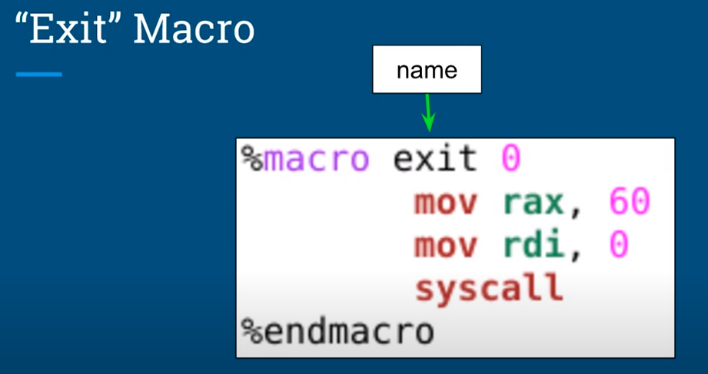

Slide 6
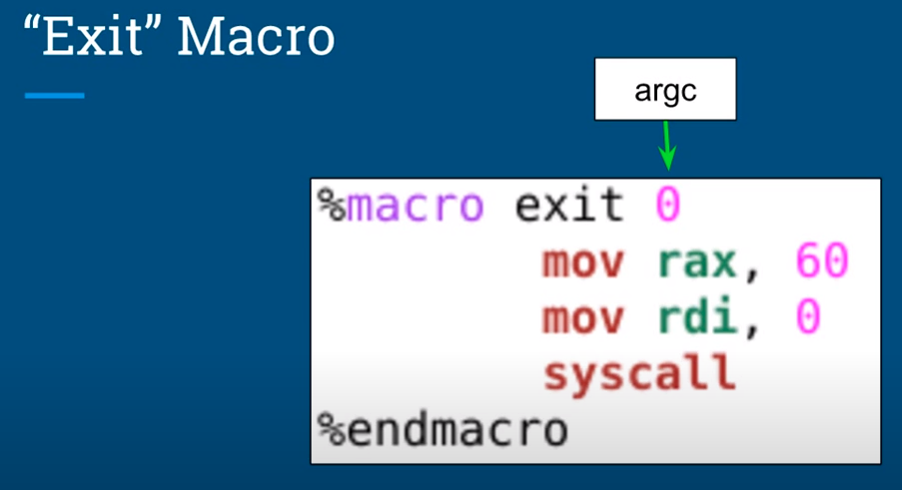

Slide 7
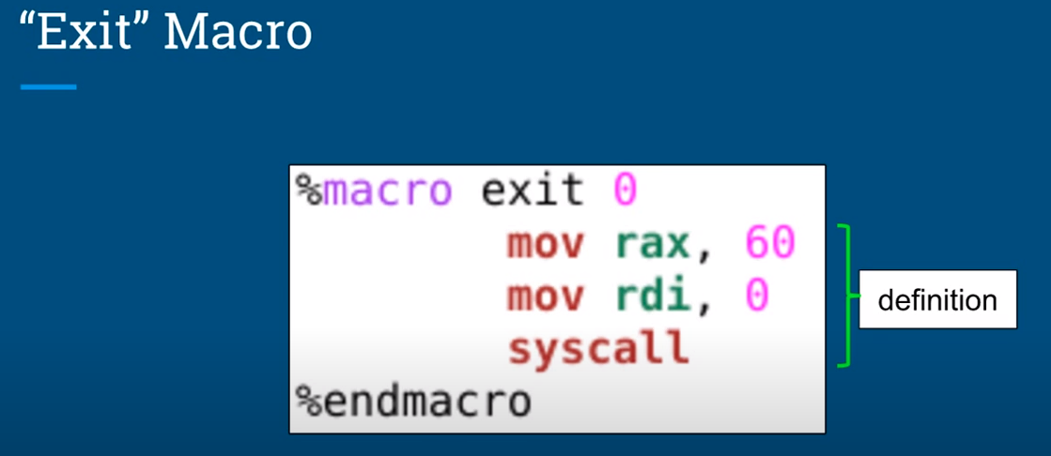

Slide 8
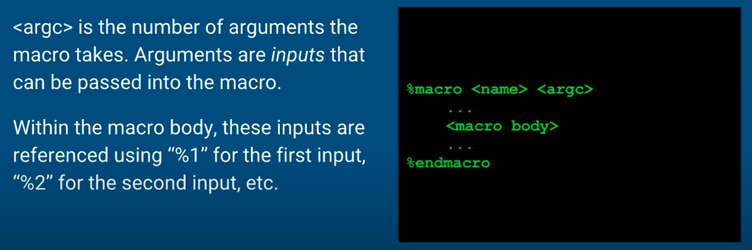
Arguments for Macros

Slide 9
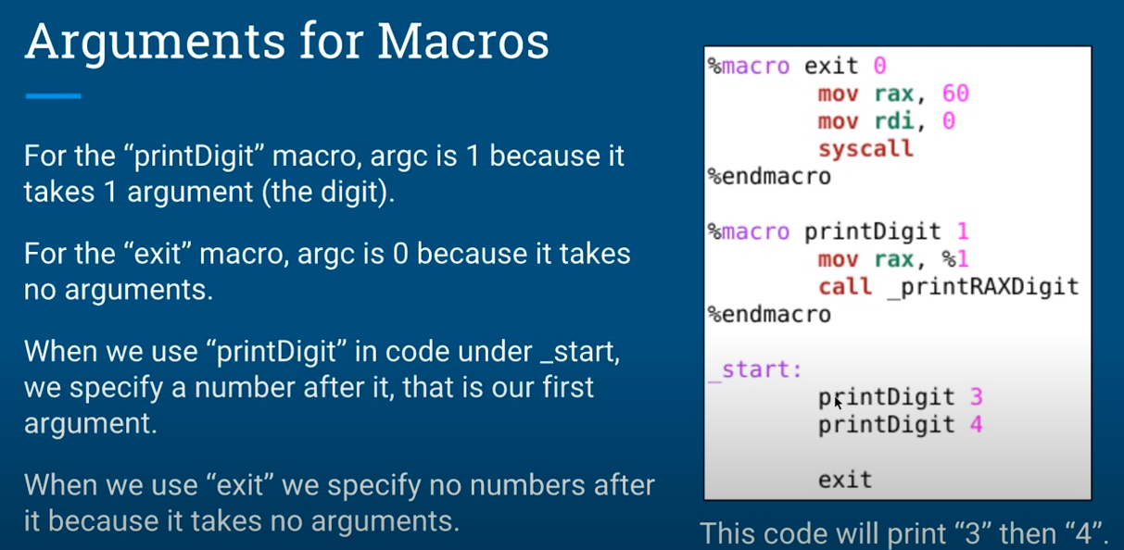

Slide 10
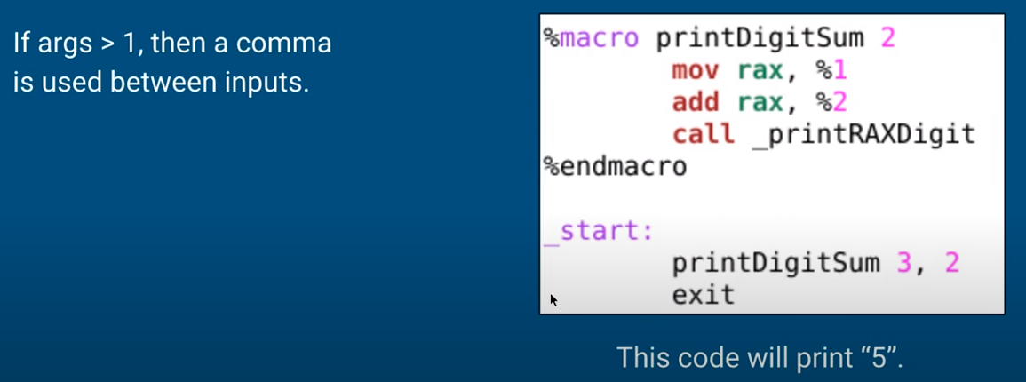
Arguments for Macros

Slide 11
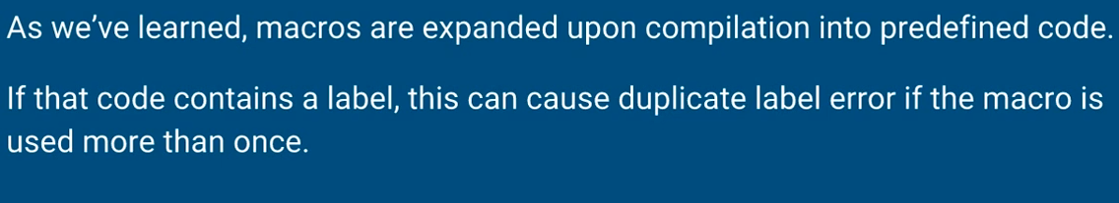
Local Labels in Macros

Slide 12
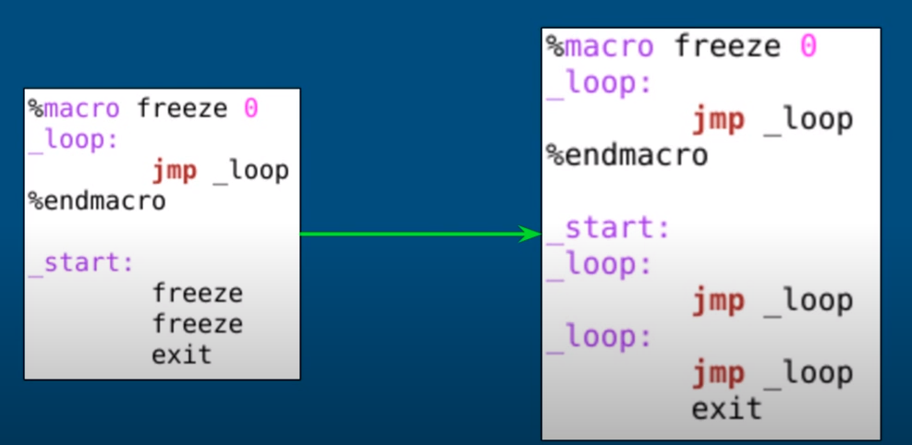
Local Labels in Macros

Slide 13
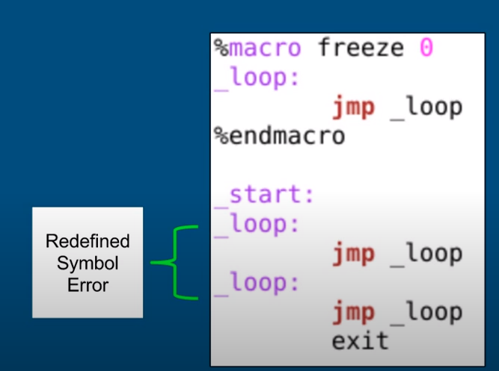
Local Labels in Macros

Slide 14
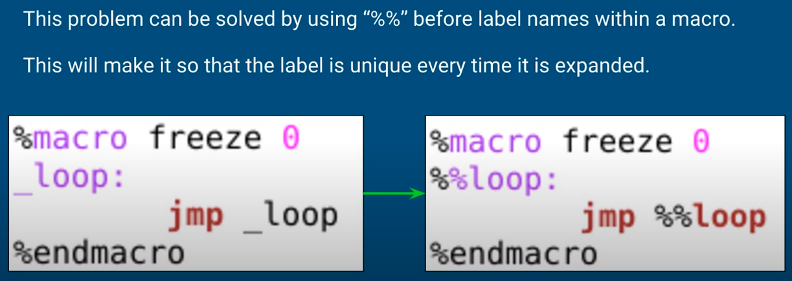
Local Labels in Macros

Slide 15
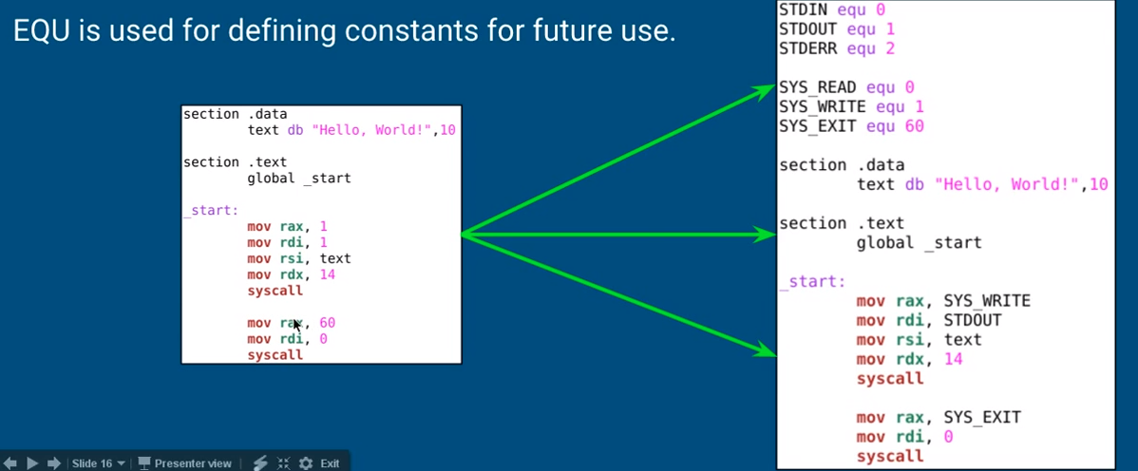
Defining Values with EQU

Slide 16
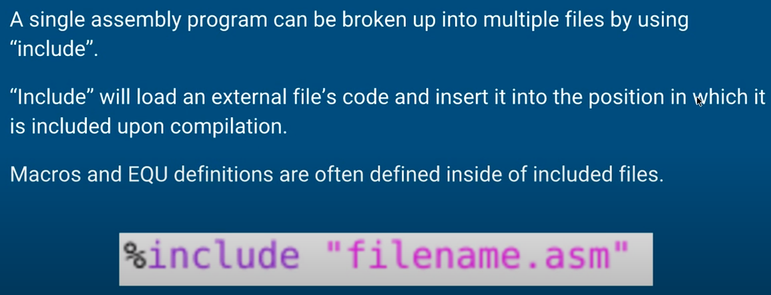
Including External Files

Slide 17
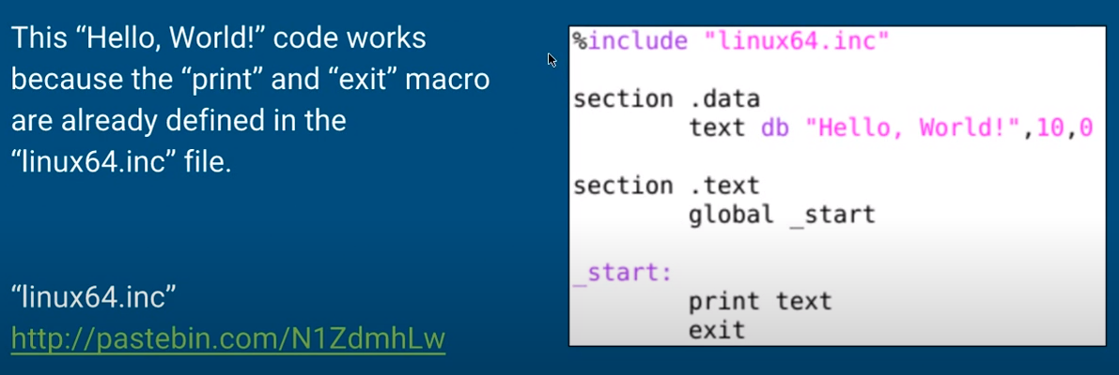
Including External Files

Slide 18
References
https://www.youtube.com/watch?v=mRTax0MLaok&list=PLetF-YjXm-sCH6FrTz4AQhfH6INDQvQSn&index=7

